Slide 1




Implementing Causal Machine Learning in Wednesday: Flanders & the use of the mcf Python package
August / September / October 2024
Michael Lechner Professor of Econometrics | University of St. Gallen | Switzerland

Slide 2
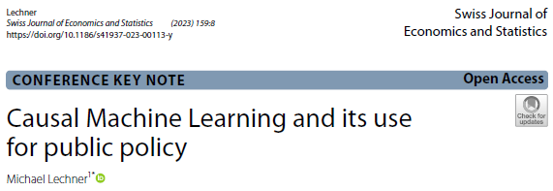
The workshop series
Astana Workshop September 30 to October 4, 2024 (10-13, 14:00-17:30)
Monday
Morning: Identification with experiments & selection on observables
Afternoon: Discussion of potential programmes to be evaluated
Tuesday: Causal Machine Learning (theory) (ends at 16:00)
Today
Empirical examples: Active labour market programmes in Flanders
The mcf package – how to use it & how to interpret the results
Thursday: Doing an empirical study in groups with the data introduced in online workshop 4
Friday: Discussion of programmes to be evaluated continued (core team only)

Slide 3

1 | Introduction
2 | Evaluation of Training in Flanders – Introduction, data, programmes, identification
3 | Evaluation of Training in Flanders – Results, optimal policy analysis, conclusions
4 | The mcf Python module: Documentation, major classes & methods
5 | The mcf Python module: Effect estimation
6 | The mcf Python module: Optimal policy
7 | The mcf Python module: Effect estimation & optimal policy

Slide 4


Slide 5
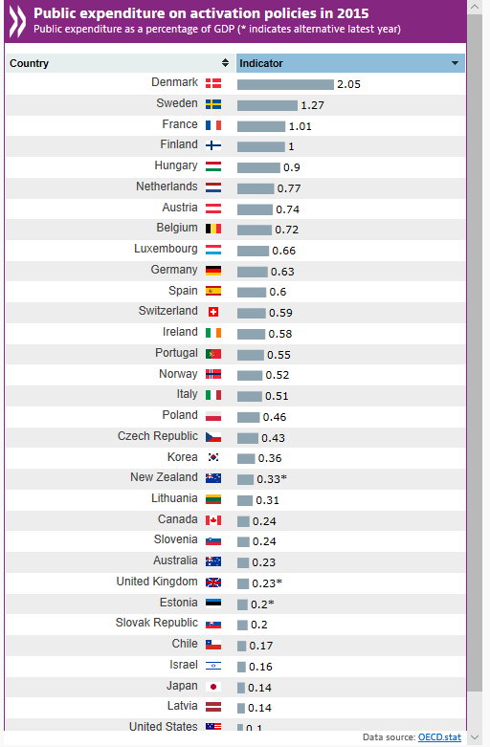
Motivation
Active Labour Market Policies (ALMP) are important public policies in Europe
Effects of ALMP are heterogenous
Knowing who benefits by how much has big advantages
Improve allocation of UE
Better understanding of why some policies help / hurt some UE
Causal machine learning methods allow to systematically estimate such heterogeneities
Downloaded 2019/Nov/20 from https://www.oecd.org/employment/activation.htm

Slide 6
Research questions
Active Labour Market Policies
What are the effects of important training components of the ALMP in Flanders?
How & by how much do their effects differ for different types of unemployed?
Can this heterogeneity be used to improve the allocation of unemployed to these programmes?

Slide 7
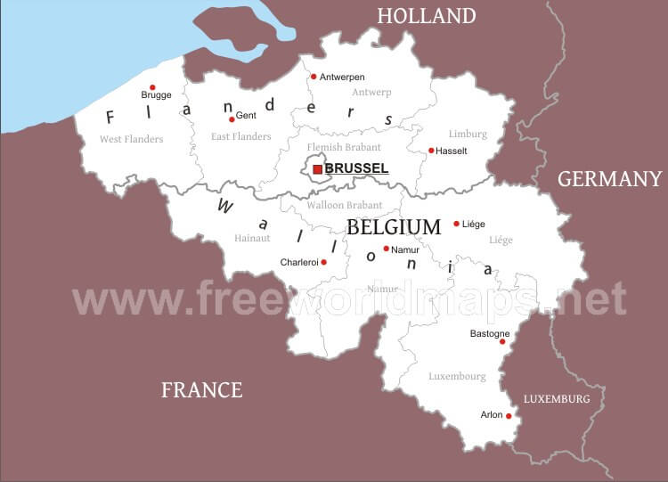
Why Flanders ?
Data access & cooperation with the Public Employment Service (PES) of Flanders
PES might consider using similar methods to improve their ALMP
External validity
Inside Flanders: Data consists of very recent Flemish unemployed
Rest of Europe: ALMP (& PES) of Flanders very similar to ALMPs of many other European countries
Labour market similar to those of (richer) European countries

Slide 8
Literature | Effects of ALMP
This has now become a very large literature in economics
Typically based on observational studies informed by rich administrative data employing a selection-on-observables identification strategy
Nice summary: Meta study of Card, Kluve, Weber (2018, JEEA)

Slide 9
Our approach in this paper
Use very recent, informative administrative data from Flanders such that CIA plausibly holds
Use Modified Causal Forest (MCF) method to investigate the effects of training programmes
Uncover mean effects & important heterogeneities
Develop simple policy rules that allow to use public resources more efficiently

Slide 10
The results of the paper in a nutshell | 1
Mixed findings for average programme effects (before subtracting costs)
In the long run, all programmes have positive effects
But their short-run (lock-in) effects differ
Considerable effect heterogeneity for all programmes
This heterogeneity appears to go in the same direction for all programmes
Non-natives benefit much more, in particular recent immigrants
Exploiting this heterogeneity for programme allocation suggests possible gains in terms of additional employment
Even when using simple, tree-based allocation rules

Slide 11
Data | 1
Administrative Data from the Flemish PES
Records start 1991 & end in 9/2019
Basic sample: Inflow into UE between Dec 2014 – June 2016
Final sample size in main analysis
No programme participation: 56’324
Short (< 6 months) vocational training: 1’305
Longer (>= 6 months) vocational training: 1’220
Orientation training: 1’115

Slide 12
Available information
Labour market status 1991-2019 (monthly/daily)
Incl. sickness spells & past participation in ALMP
Individual socio-demographics
Gender, age, education & skills, migration background, position in household, # of kids, …
Knowledge of Dutch & foreign languages, different drivers licences
Location of living (district level)
Sector & job position in last employment prior to relevant UE spell, experience
Most preferred profession at beginning of current UE spell

Slide 13
Programmes evaluated
Programmes considered in main analysis
Short (< 6 months) vocational training
Longer (6 months -10 months) vocational training
Orientation training
Programme considered in additional analysis
Intensive counseling
Placebo analysis suggested reasonable doubts on credibility of results

Slide 14
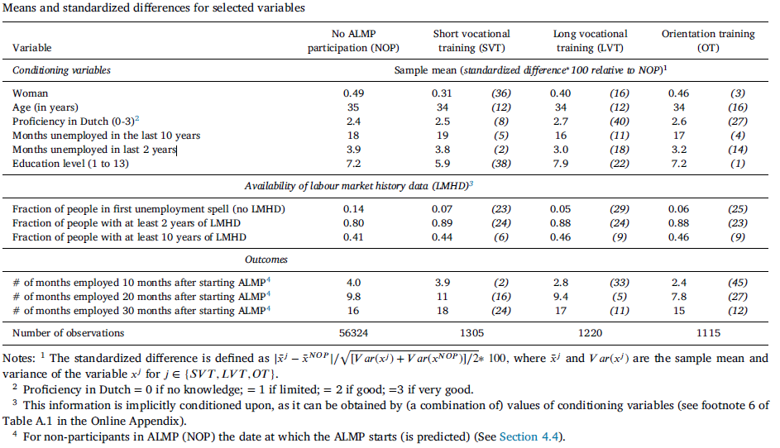
Descriptive statistics

Slide 15
Identification
Literature agrees that unconfoundedness is usually plausible for evaluation of ALMP with informative, long-term government data
This is given in this study

Slide 16
1 | Introduction
2 | Evaluation of Training in Flanders – Introduction, data, programmes, identification
3 | Evaluation of Training in Flanders – Results, optimal policy analysis, conclusions
4 | The mcf Python module: Documentation, major classes & methods
5 | The mcf Python module: Effect estimation
6 | The mcf Python module: Optimal policy
7 | The mcf Python module: Effect estimation & optimal policy

Slide 17
General aspects
Abundance of results (> 300’000 parameters estimated)
# of IATE (N x 4 (no of treatments) * 3 / 2) + # of GATEs + # of ATE
Concentrate on most important aspects
Main outcome variable of interest: Monthly employment
Either in month m or cumulatively over m months
Policy target variable & of economic interest
Alternative policy target variable in paper: Unemployment
Comparison to non-participation only
Other comparisons in paper
ATE & GATE only
ATET & GATET (partly) in paper

Slide 18
Results
Outcome variables
Employment or unemployment in particular month after start of training
Time window: 30 months available for everybody
Different aggregation levels over time
Month by month → dynamics of effect
Aggregated over certain periods
All 30 months: Summary measure for heterogeneity checks
Heterogeneity may be different over time
Beginning (lock-in period)
Last 12 months (effects reached long run level)
Comparisons: Here, comparisons to non-participation only (see paper for more …)

Slide 19
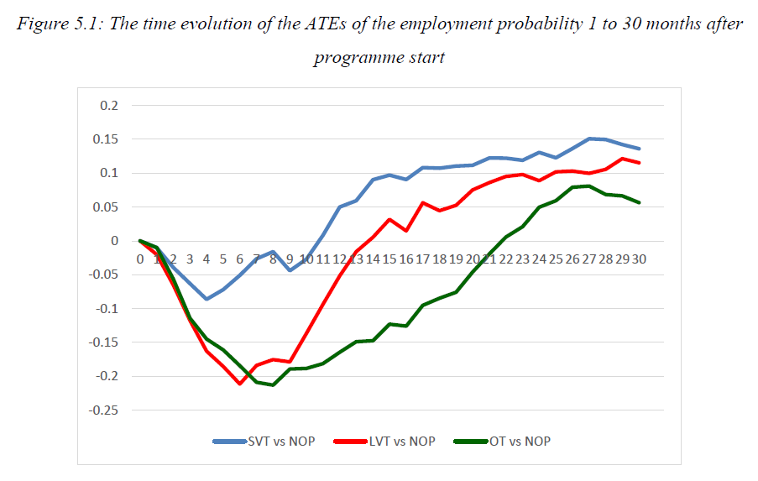
All programmes have …
- lock-in effects < 0 - long-run effects > 0
Employment level approx. 65%
OT worst
- largest lock-in
- smallest long-run
SVT superior to LVT
- smaller lock-in
- same long-run effect

Slide 20
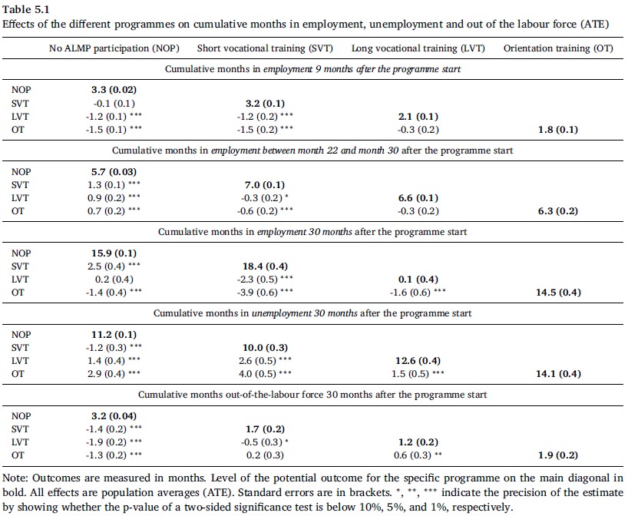
Other outcome variables

Slide 21
A priori relevant heterogeneity | GATEs | 1
The following variables have been investigated for (univariate ) heterogeneity (p-value of F-Test for effect homogeneity if < 10%)
Past unemployment history
Sex
Living in city
Sickness
Start of programme spell
Age
Dutch Language (SVT-NOP: 2%, OT-NOP: 3%)
Country of birth (SVT-NOP : 5%, LVT-NOP : 10%)
Education (SVT-NOP : 0%)
Careful interpretation warranted because of multiple-testing

Slide 22
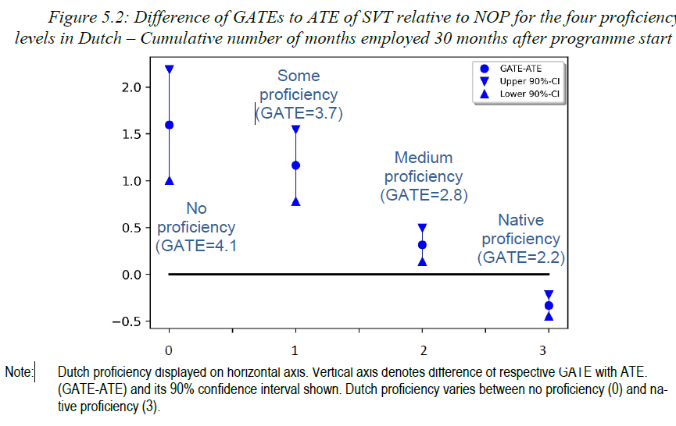
A priori heterogeneity | GATEs minus ATE | SVT

Slide 23
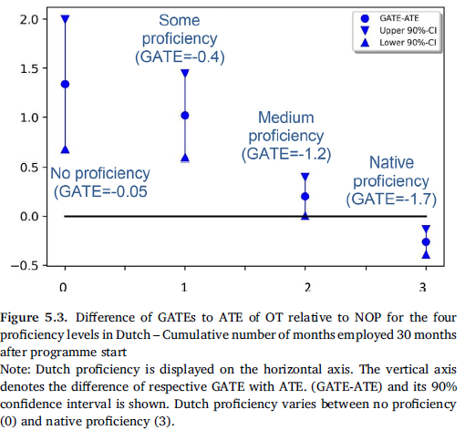
A priori heterogeneity | GATEs minus ATE | OT

Slide 24
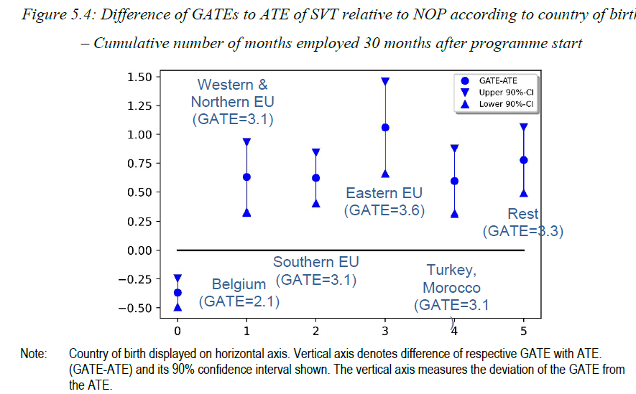
A priori heterogeneity | GATEs minus ATE | SVT

Slide 25
A priori relevant heterogeneity | Cumulative Effects
Programmes more effective for UE who are / have …
Lock-in period & long-run
Migrants / Bad proficiency in Dutch language
Only lock-in period
Bad risks in the labour market
Older
Start programme later
Lower education (in particular no vocational training)
Worse employment history
No detectible systematic differences for …
Sickness, sex, living in city

Slide 26
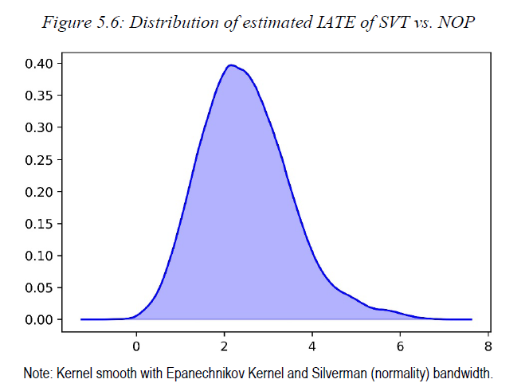
IATE ST vs. NP Std.: 2.0, sig. at 5%: 49%
IATE LT vs. NP Std.: 1.4, sig. at 5%: 2%
IATE OT vs. NP Std.: 1.5, sig. at 5%: 13%

Slide 27
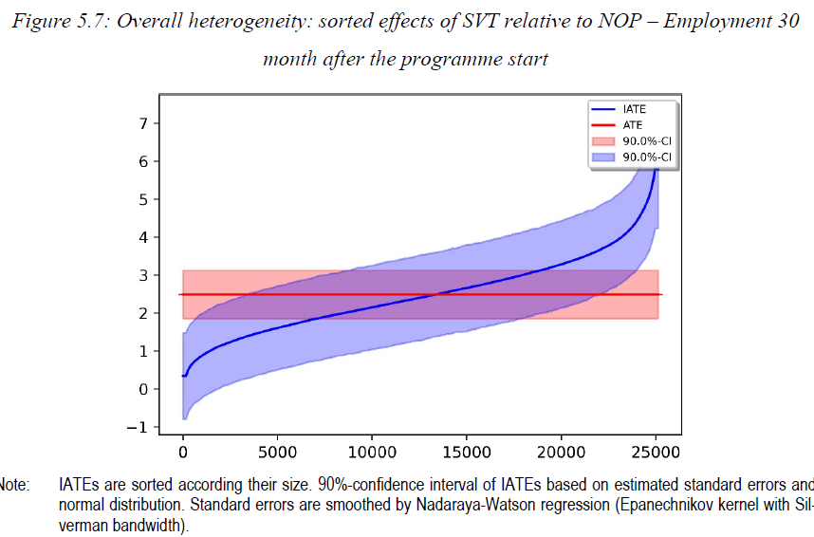

Slide 28
Detecting heterogeneity | Clustering
IATEs (programme relative to non-participation) are (jointly) clustered into 8 different groups
K-means++ algorithm
Clustering based on estimated effects (IATE(x))
Compare mean (& std) of features across groups
Results
Clustering monotone in effectiveness of all programmes
Clear differences in features

Slide 29
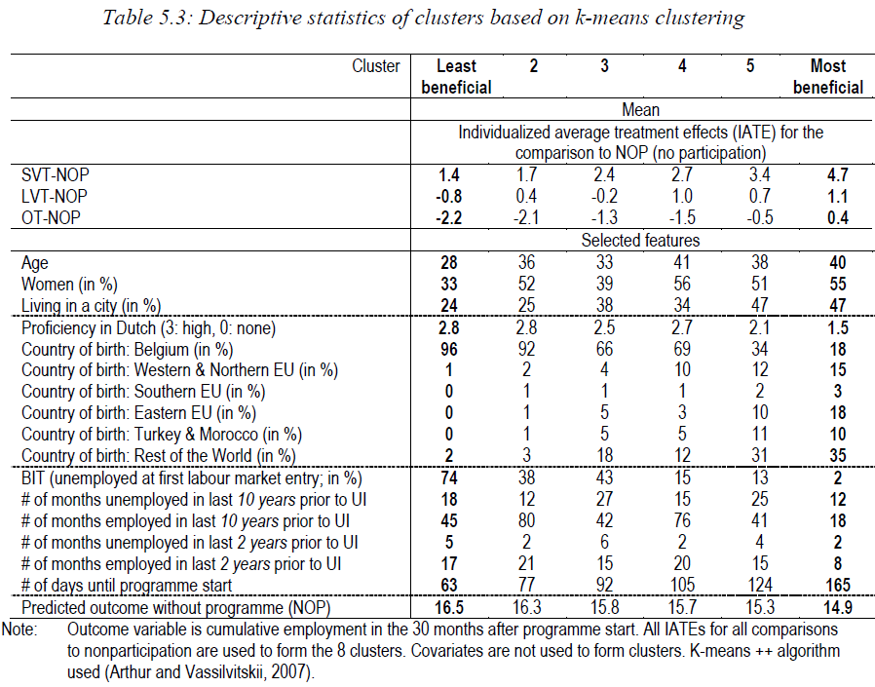
Used for clustering

Slide 30
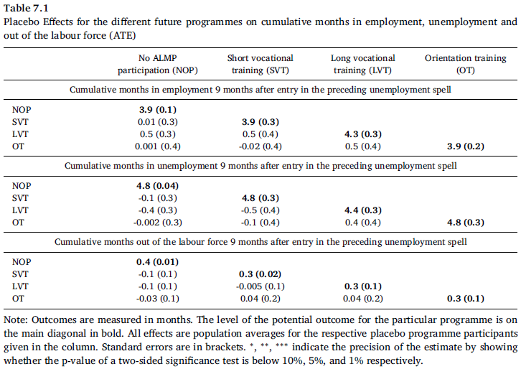
Placebo analysis (using the previous UE spell)

Slide 31
Policy simulations | 1
Use IATEs to reallocate unemployed to different programmes
No explicit cost data: 3 basic scenarios w.r.t. budget constraints
Unconstraint
Observed share of all participants as upper bound
Observed share of participants in particular programme as upper bound
Target variable: Months of employment & (minus) unemployment (equally weighted; summed up in first 30 months)
Two different ways to obtain alternative allocations
Black-Box approach
Optimize potential outcomes generally
Policy Trees as restricted policy class
Find simple rule that reaps in almost all benefits

Slide 32
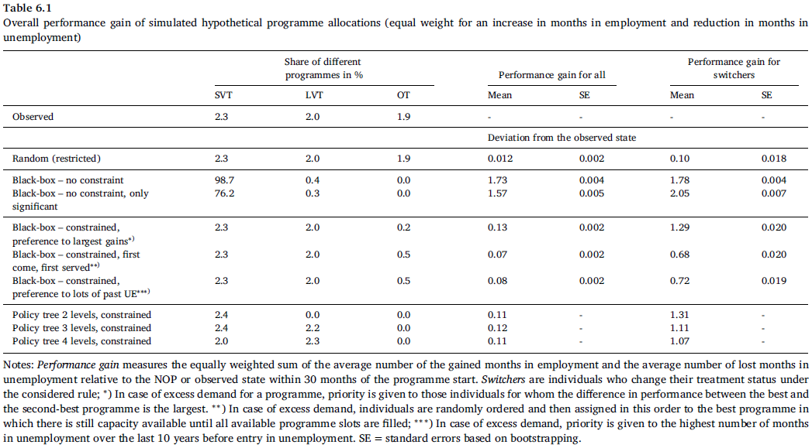
xxx
c

Slide 33
Policy simulations | Results | 1
Results
Caseworkers allocate UEs into programme without taking IATEs into account
Maximum gain of 3 months of additional employment in 30 months
Costly, because share of SVT increases massively
Limited total gains if programme shares are kept fixed
Programmes are too small to change much in overall employment
But big relative improvement: about 0.4 months additional employment overall by reallocating max 10% of UE (max 5% in programme)
Such a black-box rule is difficult to ‘sell’ to UE and CW

Slide 34
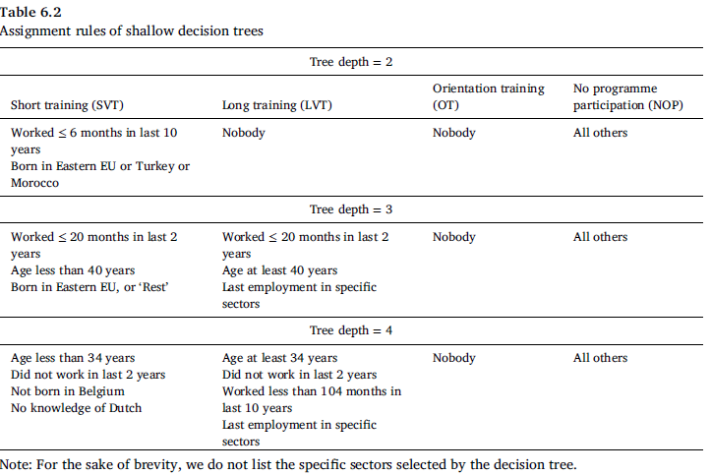

Slide 35
Conclusions | 1
Mixed findings for average programme effects
Short vocational training works
Only very small group does not benefit
Long vocational training is more doubtful overall
Lock-in effect large, but also positive long-run effects
Considerable underlying effect heterogeneity
Orientation training
On average negative effects because of large lock-in effects
However, for recently immigrated foreigners it appears to work

Slide 36
Conclusions | 2
Heterogeneity
Considerable heterogeneity for all programmes
Appears to have the same direction for all programmes
Non-natives benefit more, in particular recent immigrants
Exploiting this heterogeneity for programme allocation suggests that gains exist by allocating unemployed to programmes differently

Slide 37
1 | Introduction
2 | Evaluation of Training in Flanders – Introduction, data, programmes, identification
3 | Evaluation of Training in Flanders – Results, optimal policy analysis, conclusions
4 | The mcf Python module: Documentation, major classes & methods
5 | The mcf Python module: Effect estimation
6 | The mcf Python module: Optimal policy
7 | The mcf Python module: Effect estimation & optimal policy

Slide 38
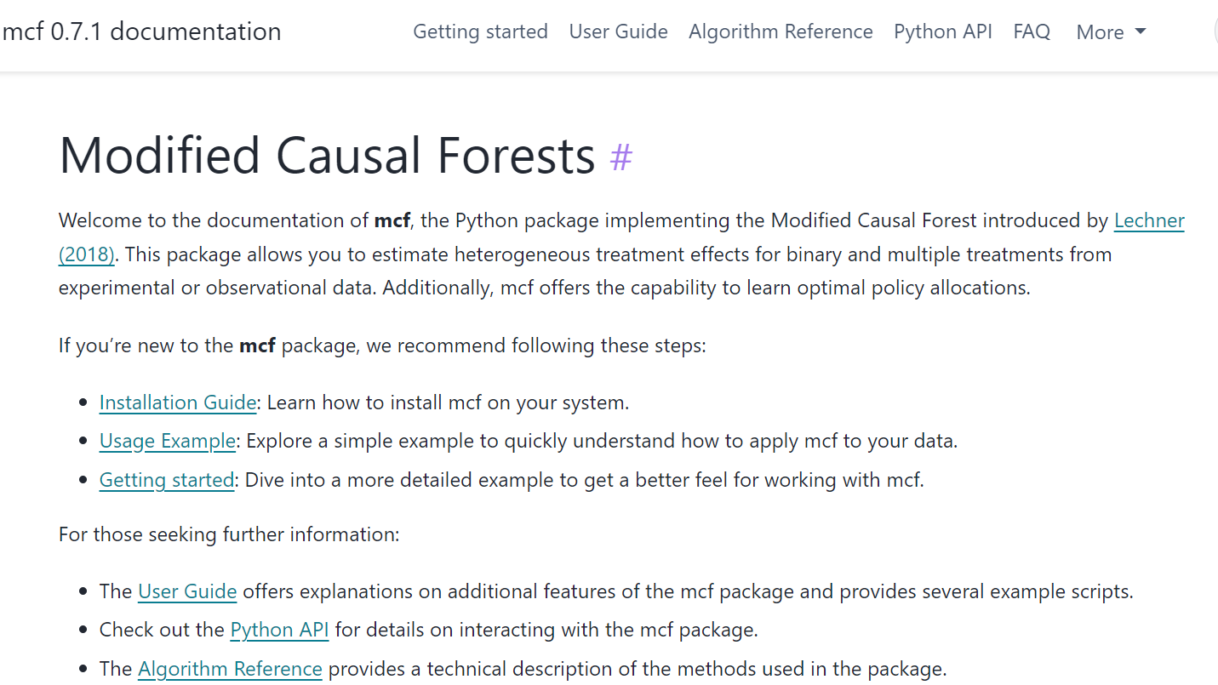

The mcf homepage
https://mcfpy.github.io/mcf/#/
c

Slide 39

Installation
This should be done & tested before the course
Install Anaconda
I am using the full Anaconda Distribution
Create an environment inside Anaconda with Python 3.12
conda install sypder [if you use Spyder; or any other conda-based IDE]
pip install mcf

Slide 40

Major classes
Modified Causal Forests — mcf 0.7.1 documentation (mcfpy.github.io)
ModifiedCausalForest(**keywords)
Effect estimation
OptimalPolicy(**keywords)
Optimal allocation based on predefined policy score
McfOptPolReport(**keywords)
Creates a pdf-file with results & explanations

Slide 41
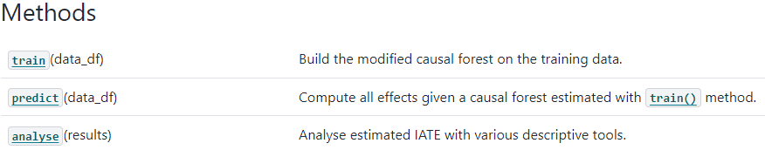
Major classes & methods of version 0.7.1 | 1
ModifiedCausalForest
train(training_data_as_DataFrame)
Trains the causal forest
Requires data on Y, D, X
predict(prediction_data_as_DataFrame)
Uses the trained forest to predict the effects with (potentially) new data
Requires data on X
analyse(results)
Analyses the estimated IATE(x) with various tools
Requires ‘results’ which is the return from the predict method

Slide 42
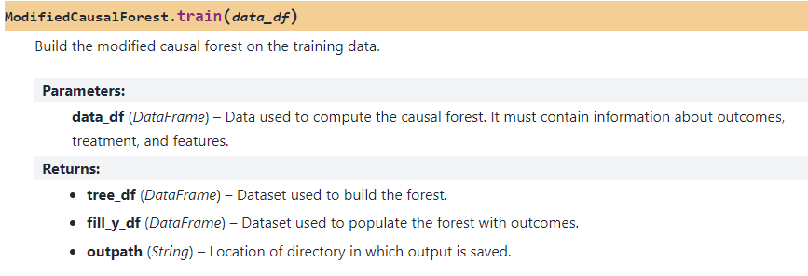
Major classes & methods of version 0.7.1 | ModifiedCausalForest | 1

Slide 43
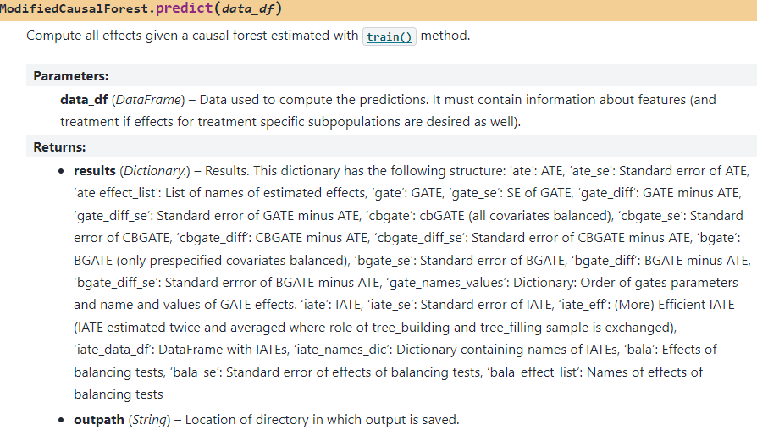
Major classes & methods of version 0.7.1 | ModifiedCausalForest | 2

Slide 44
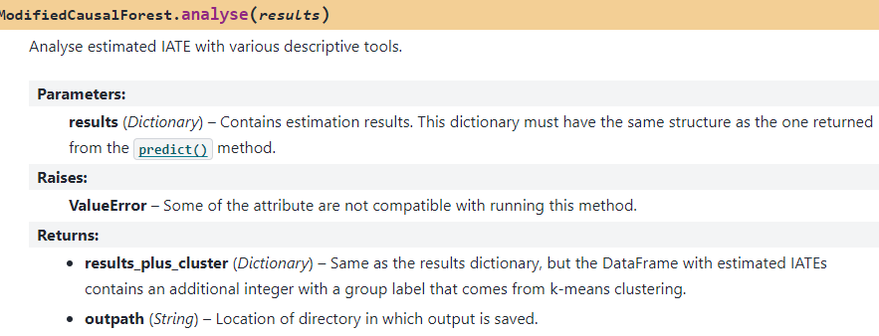
Major classes & methods of version 0.7.1 | ModifiedCausalForest | 3

Slide 45
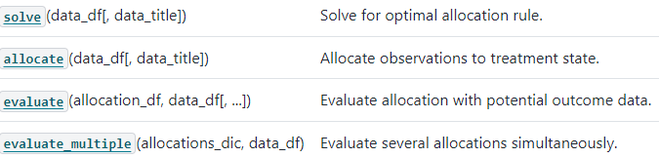
Major classes & methods of version 0.7.1 | OptimalPolicy | 1
solve(training_data_as_DataFrame)
Train the optimal assignment algorithm
allocate(allocation_data_as_DataFrame)
Allocate (possible new) data to optimal treatment state
evaluate(allocations_as_df, allocation_data_as_DataFrame)
Evaluate the allocation
evaluate_multiple(allocations_as_dic, allocation_data_as_DataFrame)
Evaluate several allocations jointly (nicer output than man single calls to evaluate)

Slide 46
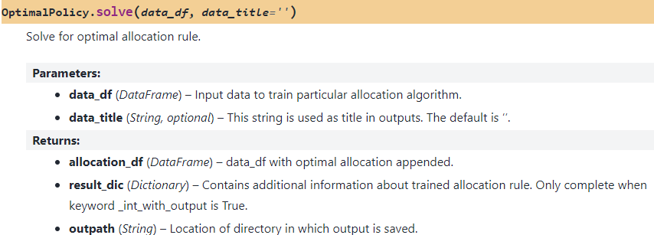
Major classes & methods of version 0.7.1 | OptimalPolicy | 2

Slide 47
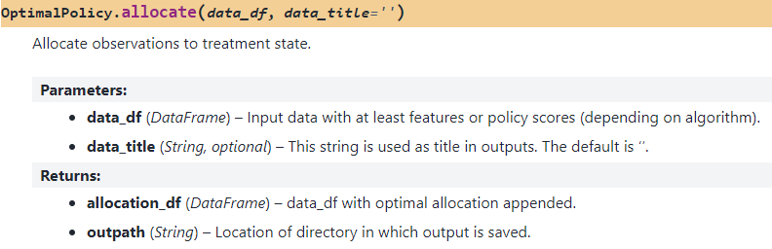
Major classes & methods of version 0.7.1 | OptimalPolicy | 3

Slide 48
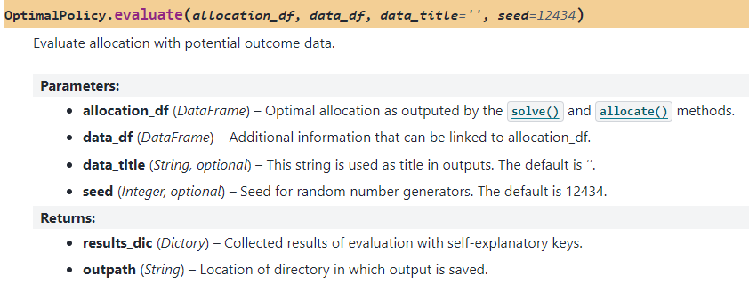
Major classes & methods of version 0.7.1 | OptimalPolicy | 4

Slide 49
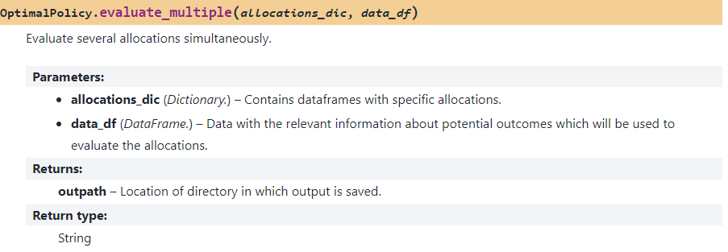
Major classes & methods of version 0.7.1 | OptimalPolicy | 5

Slide 50
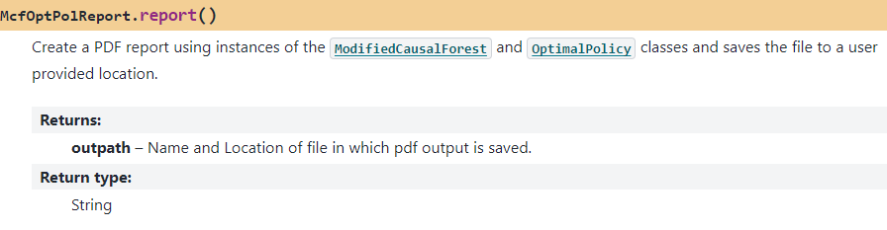
Major classes & methods of version 0.7.1 | McfOptPolReport | 1
report()
Create a pdf file with results & additional explanations (additionally to standard results)

Slide 51
1 | Introduction
2 | Evaluation of Training in Flanders – Introduction, data, programmes, identification
3 | Evaluation of Training in Flanders – Results, optimal policy analysis, conclusions
4 | The mcf Python module: Documentation, major classes & methods
5 | The mcf Python module: Effect estimation
6 | The mcf Python module: Optimal policy
7 | The mcf Python module: Effect estimation & optimal policy

Slide 52

Effect estimation | all_parameters_mcf.py
Structure of example programme
Import functions & classes
Generate data (l. 51; example_data())
Define keywords (or use defaults) & collect them in dictionary (l.659)
Initialize instance: mymcf (l. 766)
Use methods with this instance: train, predict, analyse (& sensitivity: experimental)
Create pdf
Keywords

Slide 53
Effect estimation | all_parameters_mcf.py | Output
After running the example programme, there are is a lot of output!
…/out/ contains a pdf file with the key results & some explanations
…/example/output contains more detailed results
mcf.py.0.6.0_Summary.txt
Summary of results (more detailed information than pdf)
mcf.py.0.6.0.txt
Big file, contains (almost) ALL information
…/ate_iate, …/common_support, …/gate
Plots (as pdf & jpeg) & data used to create plots (useful if you want to create ‘nicer’ plots)

Slide 54
1 | Introduction
2 | Evaluation of Training in Flanders – Introduction, data, programmes, identification
3 | Evaluation of Training in Flanders – Results, optimal policy analysis, conclusions
4 | The mcf Python module: Documentation, major classes & methods
5 | The mcf Python module: Effect estimation
6 | The mcf Python module: Optimal policy
7 | The mcf Python module: Effect estimation & optimal policy

Slide 55

Optimal policy | all_parameters_optpolicy.py
Structure of example programme
Import functions & classes
Generate data (l. 56; example_data())
Define keywords (or use defaults) & collect them in dictionary (l. 346)
Loop over several different methods to determine optimal allocations
Initialize instance: myopt (l. 386)
Use methods with this instance: solve, evaluate, allocate
Compute how much time was needed for the different steps (l. 404)
Create pdf (l. 407)

Slide 56
Optimal policy | all_parameters_optpolicy.py | 2
Keywords
Output
Different methods used for allocation
outputOPTBPS
Allocating according to best score
outputOPTBPS_CLASSIF:
Allocation with classifier (trained on allocation based on best score)
outputOPTPT
Allocation based on Policy Tree
For all methods, there are 2 files containing the results
OptPolicy.0.7.0.txt, OptPolicy.0.7.0_Summary.txt

Slide 57

1 | Introduction
2 | Evaluation of Training in Flanders – Introduction, data, programmes, identification
3 | Evaluation of Training in Flanders – Results, optimal policy analysis, conclusions
4 | The mcf Python module: Documentation, major classes & methods
5 | The mcf Python module: Effect estimation
6 | The mcf Python module: Optimal policy
7 | The mcf Python module: Effect estimation & optimal policy

Slide 58

Effect estimation & optimal policy | mcf_optpol_combined.py
Combines effect estimation with optimal policy
IATEs(d,0; x) estimated by mcf are used as policy scores
Uses all 3 classes sequentially
Same output & keywords as for estimation & optimal policy
New: Additional sample splitting (l. 69)
Sample used to train mcf (40%)
Sample used to train optimal policy algorithm (40%)
Sample used to evaluate optimal policy algorithm (20%)

Slide 59
Tomorrow: Your own empirical evaluation project
Michael Lechner
Swiss Institute for Empirical Economic Research (SEW) University of St. Gallen | Switzerland

